Slide 1
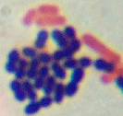
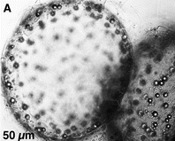
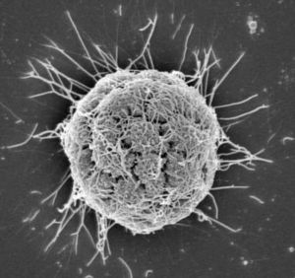
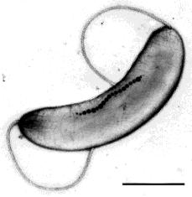
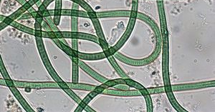
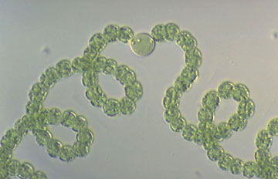
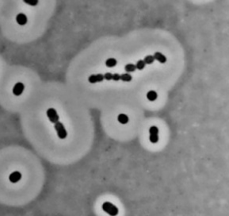
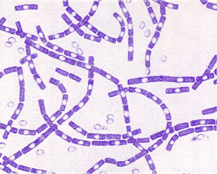
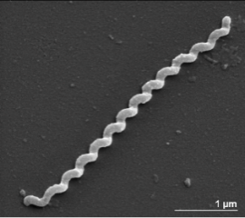
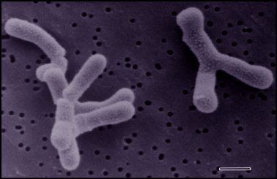
BM211 Introduction to Microbiology Workshop 1 – Microbial Ecology
Dr. Leighton Pritchard
leighton.pritchard@strath.ac.uk
@widdowquinn
Dr. Morgan Feeney morgan.feeney@strath.ac.uk @mostlymicrobia

Slide 2
Workshop 1 Learning Outcomes
By the end of this workshop, you should understand:
That microbes are diverse and play important roles in the environment
The use of Winogradsky columns to study microbial ecology
(something about alpha and beta diversity, hopefully)
And you should be able to:
Open and examine .csv files in R Studio
Use ggplot2 to make different types of plots

Slide 4
Life on this planet is mostly microbial
Microbes are diverse, able to adapt to, and grow/thrive/reproduce in diverse environments
Hug, L. A., Baker, B. J., Anantharaman, K., Brown, C. T., Probst, A. J., Castelle, C. J., et al. (2016). A new view of the tree of life. Nature Microbiology, 1–6. http://doi.org/10.1038/nmicrobiol.2016.48

Slide 5
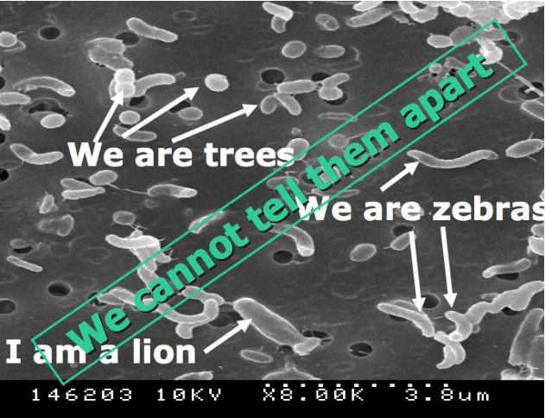
Microbial Ecology
Measuring microbial diversity:
How many species are present? → species richness
How abundant are they? → species evenness
How do we measure?
Culture-independent methods (i.e. 16S rRNAs, OTUs, metagenomics)
Culture-dependent methods (dependent on method, conditions, “culturability” of microbes)

Slide 6
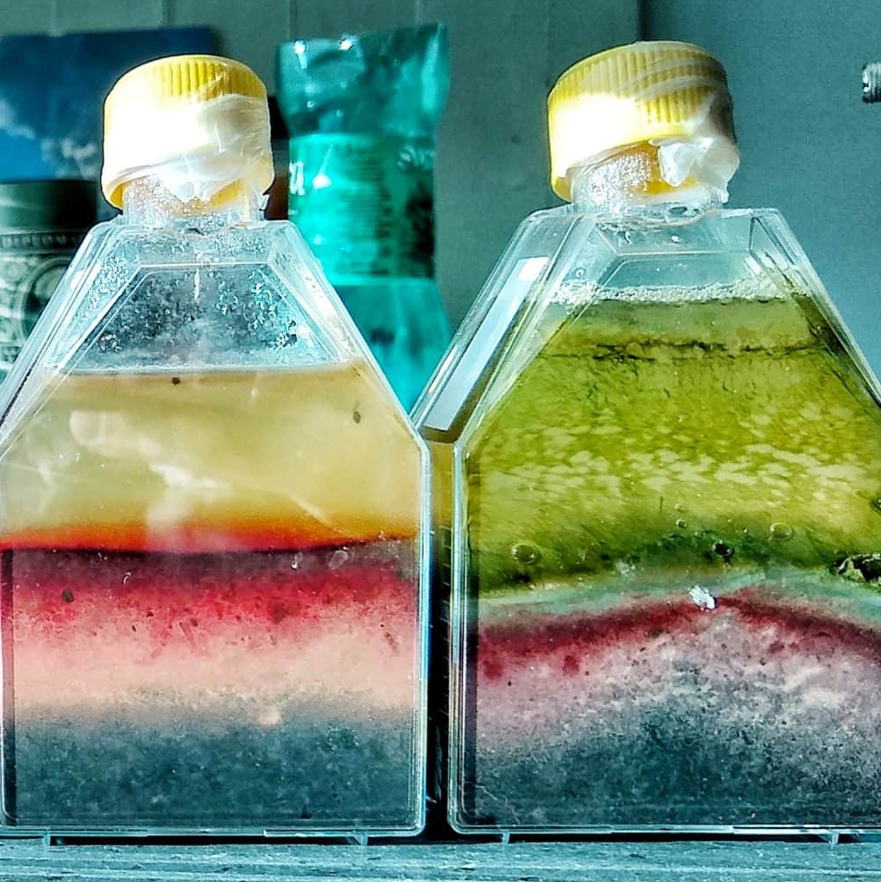
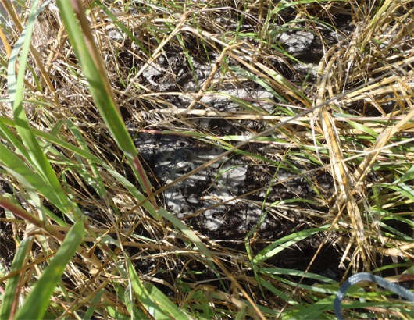
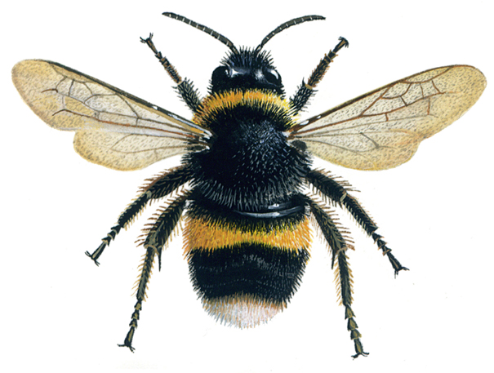
Today’s workshop structure
3 case studies that illustrate key principles in microbial ecology and diversity
Practice with data analysis working with R studio and ggplot2
1: Winogradsky columns
2: Oil spill clean-up
3: Bee microbiome

Slide 7
Why are we using R Studio?
Reproducible analyses
Complex data analysis, modelling, and visualisation capabilities
Wide range of packages available for differenta nalyses
Open source, collaborative, freely available
Excellent transferrable skills (honours thesis project, other courses, masters/PhDs, jobs…)

Slide 8
Some notes on data management best practices – start forming good habits today
There is no one correct way to organise a project or data, but there are good principles for project and data management
Use a single working directory per project or analysis (and name it after the project or analysis)
Use clear, self-describing, readable file names
Back up your files/data
Treat raw data as read-only
Place cleaned data in a separate file/folder
Place output/analysed data in a separate file/folder
Clean your data in an automated, reproducible way.
Store all data and analysis in a human-readable format
Automate your analysis as much as possible

Slide 9
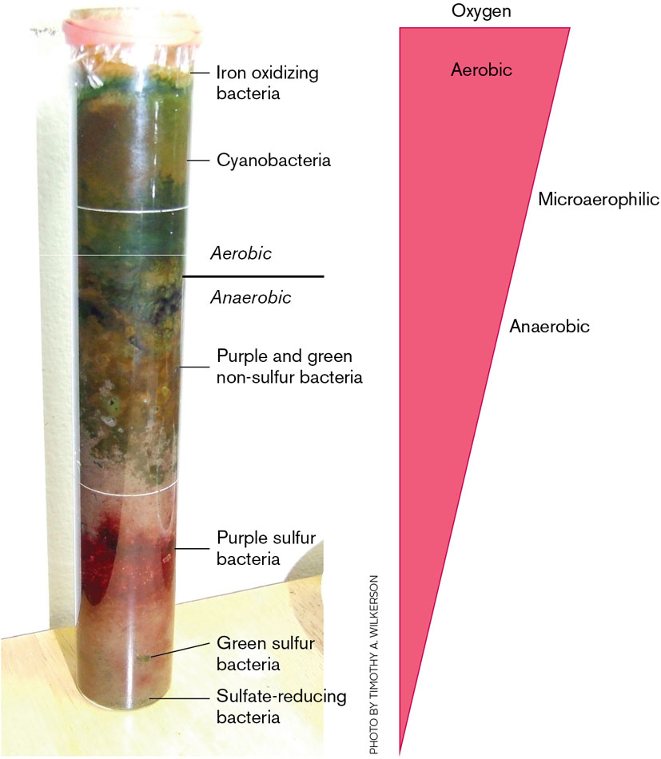
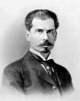
Sergei Winogradsky
Case study 1: Winogradsky columns
artificial microbial ecosystems
enrichment cultures (for different microbes depending on the substrate(s) added)
gradients of oxygen and other nutrients form; microbes grow in different zones according to their physiology
Pioneering molecular microbiologist and microbial ecologist
Biogeochemical cycles (N,S)
Chemosynthesis
Image credit: https://en.wikipedia.org/wiki/Sergei_Winogradsky

Slide 10
Winogradsky column experimental design details

Slide 11
Winogradsky column data → R Studio demo

Slide 12
Winogradsky column data → R Studio demo
Which of the plots is "best"/most effective/most useful?
How would you interpret these data? Which column do you think has the most cyanobacteria?
Are there any flaws in the experimental design?
Can you think of other ways to visualise and/or present these data?
Does the audience you are presenting the data to matter?
How would you present these data for publication in a scientific journal?

Slide 13
Case study 2:
Atlas RM, Stoeckel DM, Faith SA, Minard-Smith A, Thorn JR, Benotti MJ. Oil Biodegradation and Oil-Degrading Microbial Populations in Marsh Sediments Impacted by Oil from the Deepwater Horizon Well Blowout. Environ Sci Technol. 2015;49(14):8356-8366. doi:10.1021/acs.est.5b00413

Slide 14
Case study 3:

Slide 15
Additional exercises and resources

